Slide 1
Storytelling Case Study - Airbnb, NYC By : Meenakshi Sharma, Pranav keshav sairipally and Manu Smriti

Slide 2
AGENDA
Objective
Background
Insights
Inference
Appendix
Data Assumptions
Data Methodology

Slide 3
Objective
Improve business strategies and estimate customer preferences to revive the business in the post-COVID period.
Analyze the critical pre-COVID period of Airbnb's business in NYC.
Make recommendations to various departments on how to prepare for post pandemic changes.

Slide 4
Background
Airbnb’s revenue has been significantly reduced in recent months as a result of COVID-19.
People have begun to travel more now that the restrictions are lifted.
Airbnb wants to make sure that it is fully prepared for this change.

Slide 5
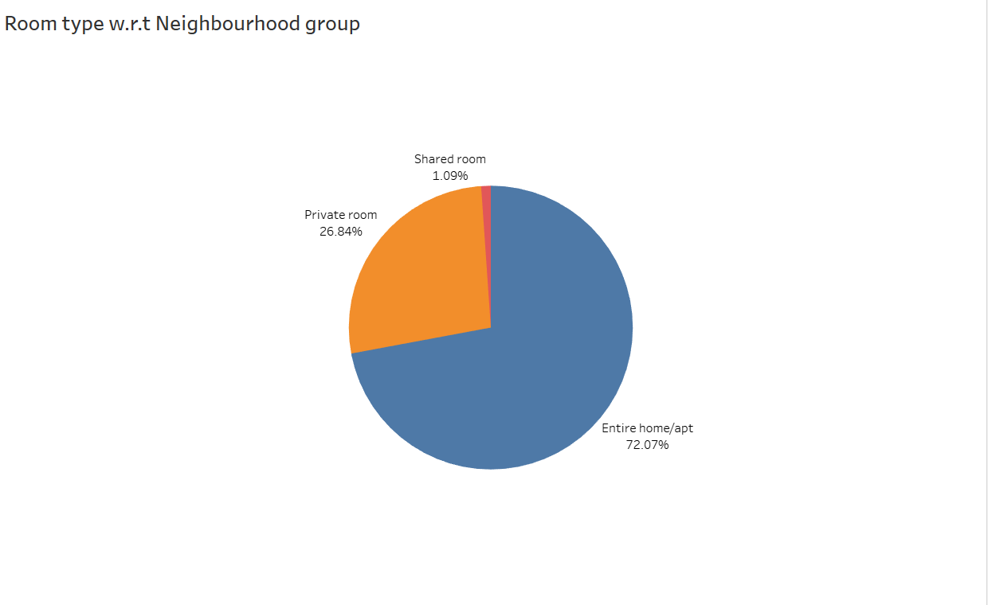
Distribution of Room Types Across NYC Neighborhood Groups
Entire home/apt account for 72.07% of total price share.
Entire home/apt and private room preferred over shared room.
Entire home/apt and private room account for the majority of listed properties in NYC (approx. 97.6%).

Slide 6
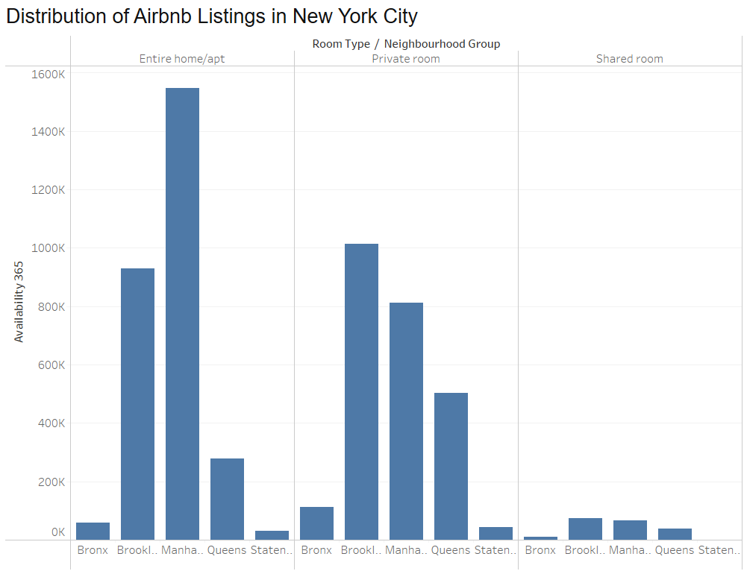
Distribution of Airbnb Listings in New York City
Manhattan and Brooklyn dominate in the number of available Entire home/apartment listings.
Private rooms have significant availability in Brooklyn and Manhattan, while queens also shows a noticeable presence.
Shared rooms have the least availability across all neighborhood groups, with a slight presence in Brooklyn

Slide 7
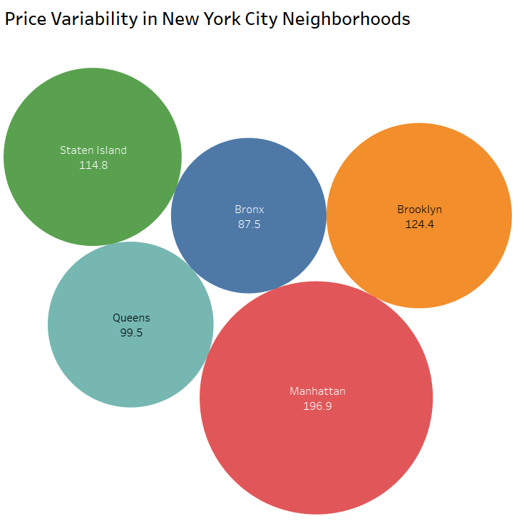
Price variability in Nyc neighborhoods
The average price of listed properties in Manhattan is around 196.9, which is highest among all neighbourhoods.
Average price for Brooklyn is second highest i.e. 124.4.
Bronx appears to be an affordable neighbourhood as the average price is almost half than Manhattan’s average price.

Slide 8
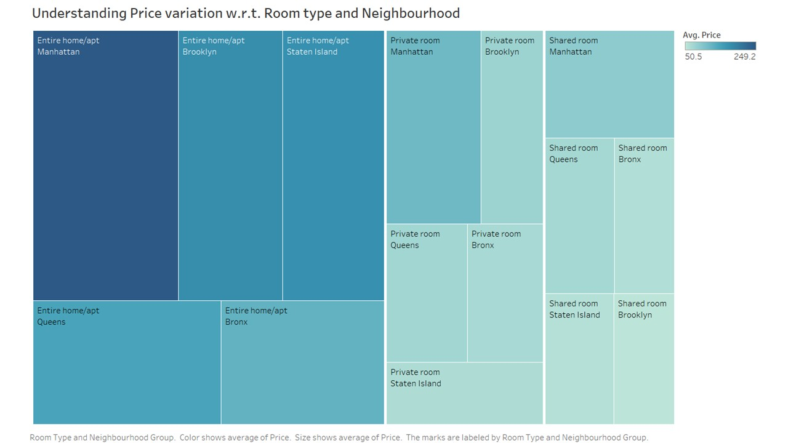
Understanding Price variation w.r.t Room Type & Neighbourhood
The “Entire home/apt room type in Manhattan is the most expensive at $250, much higher than the overall average.
“Private rooms” of Manhattan & Brooklyn has the highest average.
“Shared room” type is the cheapest in Brooklyn with $50.5.

Slide 9
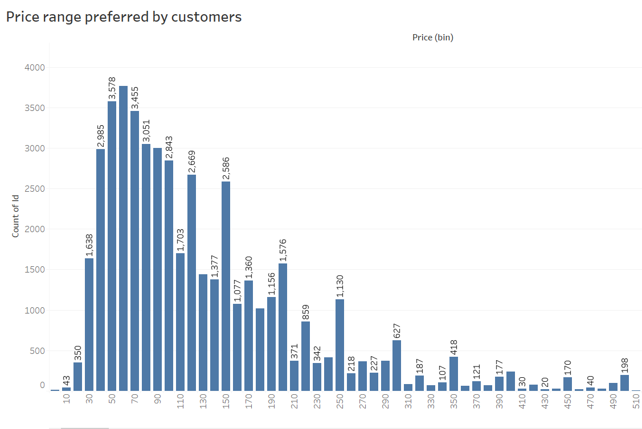
price range preferred by customers
We have taken pricing preference based on volume of bookings done in a price range.
The favorable price range is $30 - $200. this is the price range preferred by most customers.

Slide 10
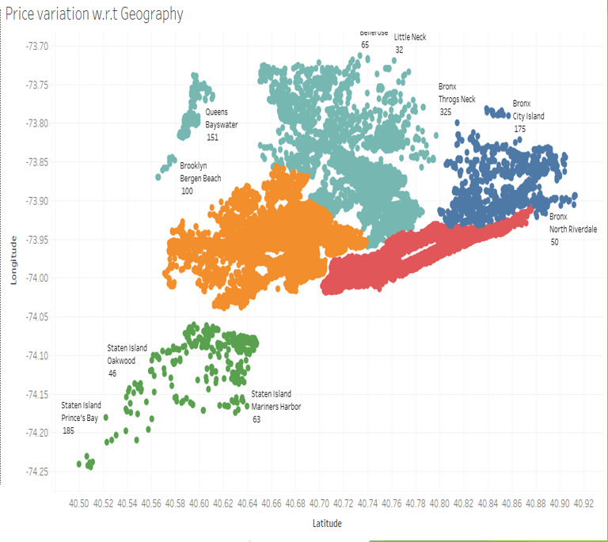
Price variation W.R.T Geography
Airbnb has good presence in Manhattan , Brooklyn and Queens.
Listings are maximum in Manhattan and Brooklyn owing to the high population density and it being the financial and tourism hub of NYC. Staten Island has the least number of listings, due to its low population density and very few tourism destinations.

Slide 11
Inference
The number of reviews is higher at lower-priced properties than at higher-priced properties as people are less likely to book expensive rooms.
Most of the listed properties are private rooms and complete homes/apt, which also account for the majority of the total price share.
Expensive prime locations like Manhattan and Brooklyn can be targeted for non premium properties and Bronx for premium properties.
The minimum number of nights to stay decreases with an increase in price.
Property host Maya from Queens has the highest number of total reviews.
Most popular listings have a minimum number of nights stay requirement ranging from 1 to 5 nights or 30 nights.
Acquire private rooms and entire home/apartments since they are more popular room type having more number of reviews per listing.

Slide 12
Appendix : Data assumptions
Assumed that pre-pandemic data was generating the desired revenue.
To learn about customer preferences, used the number of reviews per listing as a popularity metric.
Assumed number of reviews provided to be positive to use as a base measure to find customer preferences.
Assumed that company does not wish to expand into new markets in NYC.
Null values are assumed to have no effect on the analysis.

Slide 13
Appendix : Data Methodology
Used Tableau to visualize data from the NYC Airbnb dataset in order to obtain accurate insights.
Checked the dataset for null values. Some columns, such as names, host_name, last_review, and reviews_per_month, had null values.
Exploratory data analysis was used to identify customer preferences based on various parameters such as area preferences, property prices, and listing preferences.
Checked the dataset for outliers.

Slide 14
Thank you

